Slide 1
KIET Group of Institutions, Ghaziabad
Object Detection Using Machine Learning
Group ID: PCSE25-39
Student Name: Vishal Soni, Vinay Upadhyay, Satyam Aditya, Sachin Kumar Yadav Semester :8 Department: Computer Science and Engineering
Name of Project Guide : Prof. Saurav Chandra
Date of Presentation : 27/05/2025
Alignment with UN Sustainable Development Goals (SDGs)
SDG 4: Enables interactive learning through real-time visual recognition tools.
SDG 11: Enhances Urban safety and planning with intelligence surveillance.
SDG 9: Promotes innovation through the application of AI in smart systems.. the means of implementation and revitalize the Global Partnership for Sustainable Development
1

Slide 2



KIET Group of Institutions, Ghaziabad
ALIGNMENT WITH UN SUSTAINABLE DEVELOPMENT GOALS (SDGS)
SDG 4: Quality Education
It can be used as an educational tool or workshop demo for students to lean about real-time object detection.
Encourages STEM skill development, preparing students and young professionals for future tech-driven careers.
SDG 9: Industry, Innovation and Infrastructure
Supports applications like smart surveillance and traffic monitoring, enabling smart infrastructure.
Uses AI and machine learning to develop cutting-edge object detection systems, driving innovation.
SDG 11:Sustainable Cities and Communities
Supports smart city development by enabling technologies like traffic management and crowd analysis.
Enhances urban safety through real-time object detection used in surveillance and monitoring systems.
2

Slide 3
KIET Group of Institutions, Ghaziabad
Problem Statement
Traditional surveillance and monitoring systems often lack real-time intelligence and rely heavily on manual observation, which can be slow and error-prone. There is an increasing demand for automated, accurate, and fast object detection solutions in areas such as public safety, traffic management, and wildlife monitoring. However, many existing systems face challenges with speed, scalability, and precision. This project addresses these issues by implementing a YOLOv3-based real-time object detection system using machine learning to provide efficient and reliable detection capabilities.
3

Slide 4
KIET Group of Institutions, Ghaziabad
Solution
This project implements a real-time object detection system using the YOLOv3 deep learning model. It automates the identification and tracking of multiple objects in video feeds, reducing reliance on manual monitoring. By processing live camera input, it provides fast and accurate detection of vehicles, pedestrians, and other objects. The system improves efficiency in surveillance, traffic management, and safety applications. Overall, it delivers a scalable and reliable AI-based solution for intelligent monitoring.
4

Slide 5
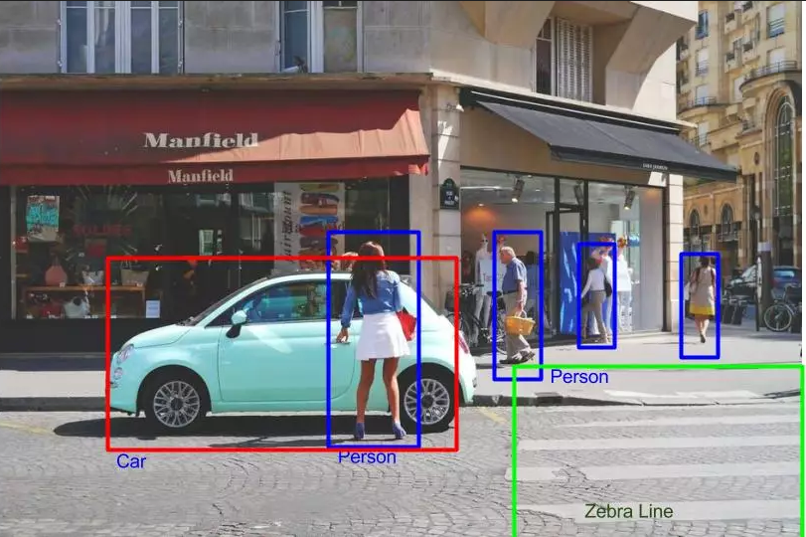
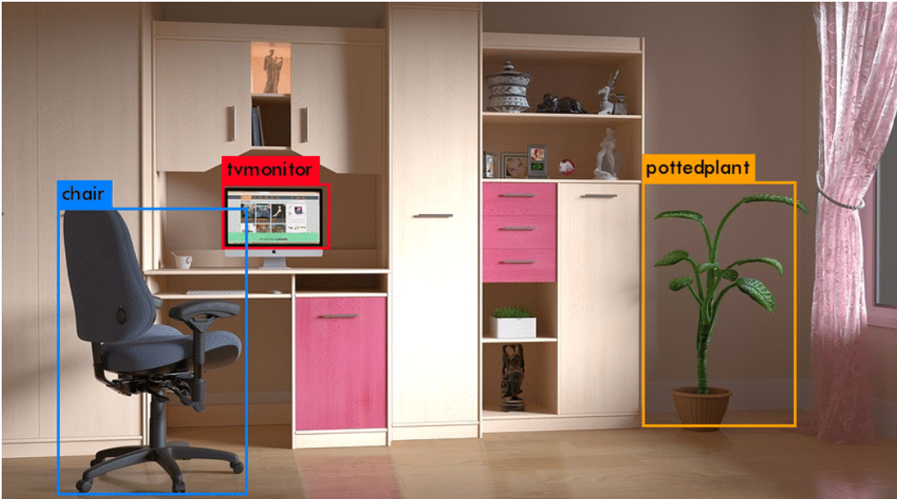
KIET Group of Institutions, Ghaziabad
5

Slide 6
KIET Group of Institutions, Ghaziabad
Project Objectives
Our 4 Major Objectives of our project are:-
Real-Time Accurate Detection:Develop a real-time object detection system using YOLOv3 to accurately identify multiple objects from live video feeds.
Automation and Efficiency: Automate monitoring processes to reduce human effort and improve the speed and reliability of object recognition.
Practical Application: Enable practical applications such as traffic management, surveillance, and safety enhancement through efficient AI-based detection.
Scalability and Adaptability:Design the system to be scalable and adaptable for integration with various cameras and environments, supporting different use cases and future enhancements.
Notes:
Immersive and Interactive Learning, Personalized and Gamified Education, Comprehensive Anatomy Knowledge, Enhanced Visualization and Exploration

Slide 7
KIET Group of Institutions, Ghaziabad
Literature Review
Introduction:
Object detection is a fundamental task in computer vision that involves identifying and localizing objects within images or video frames. It has numerous applications including surveillance, traffic monitoring, and industrial automation, making it a critical technology in many fields.
Benefits of Object Detection:
Object detection using machine learning offers numerous benefits, including enhanced accuracy and speed in identifying objects within images or videos. It automates monitoring tasks, reducing the need for manual intervention and minimizing human error. Real-time detection enables immediate responses in critical applications like traffic control and security. The technology also supports scalability, allowing integration with various devices and environments. Overall, it improves efficiency, safety, and decision-making across multiple industries.
Use Cases and Applications:
Object detection technology is widely used across various fields. In traffic monitoring, it helps detect and classify vehicles and pedestrians to improve road safety and manage congestion. Surveillance systems use it for real-time threat detection and security monitoring. Industrial automation benefits from object detection by enabling quality control and robotic guidance. Additionally, it finds applications in retail for inventory management and customer behavior analysis. These diverse uses demonstrate the versatility and impact of object detection in real-world scenarios.
7

Slide 8
KIET Group of Institutions, Ghaziabad
Challenges and Limitations:
Object detection faces challenges like occlusion and overlapping objects, which reduce accuracy. Real-time processing requires high computational power, limiting deployment on low-resource devices. Models depend heavily on the quality and diversity of training data for good generalization. Variations in lighting and camera angles can affect detection consistency. Detecting small or distant objects remains difficult, impacting overall reliability.
Current Trends and Future Directions:
Recent trends focus on lightweight and efficient models like YOLOv5 for real-time use on edge devices. Transformer-based architectures are improving detection in complex scenarios. Future work aims to better handle occlusion and small object detection. Integration with tracking and behavior analysis is growing for smarter applications. Advances in hardware and cloud-edge computing will boost deployment in areas like autonomous vehicles and smart cities.
Conclusion:
Object detection using machine learning has transformed how we analyze images and videos by enabling accurate and real-time identification of objects. Deep learning models like YOLOv3 offer a good balance of speed and accuracy, making them suitable for practical applications. Despite challenges such as occlusion and computational demands, ongoing research continues to improve these systems. The integration of advanced techniques promises even greater robustness and efficiency in the future. This technology has significant potential to impact areas like traffic monitoring, security, and automation. Overall, object detection is a vital tool driving innovation in computer vision and AI.
8

Slide 9
Course Outcomes (COs) Alignment
CO No. | CO Description | Project Alignment
CO1 | Analyze and describe the problem domain | Identified the need for real-time object detection using machine learning in areas like surveillance, automation, and safety.
CO2 | Formulate clear work plan and procedure | Followed a systematic approach: problem definition → data/model selection (YOLOv3) → implementation (OpenCV, gTTS, Pyglet) → testing with webcam input.
CO3 | Describe and evaluate both generic and specific skills | Applied domain-specific tools (YOLOv3, OpenCV, NumPy) and also used general programming practices (Python, modular functions, real-time loops).
CO4 | Design and apply modern tools for designing and drafting | Used modern ML and CV frameworks like YOLOv3, OpenCV, and integrated real-time streaming and audio feedback (gTTS + Pyglet).
CO5 | Design report and presentation | Prepared detailed documentation and presentation of the project

Slide 10
Program Outcomes (POs) Alignment
PO No. | PO Description | Project Contribution
PO1 | Apply mathematics, statistics, CS, and engineering to hardware/software | Used machine learning and OpenCV for real-time object detection.
PO2 | Identify and solve hardware/software problems | Solved the challenge of detecting and classifying objects from a live webcam feed.
PO3 | Automate real-time problems, implement programs, analyze and interpret data | Automated object recognition using YOLOv3 and real-time image processing.
PO4 | Design systems/components meeting real-world constraints | Designed a scalable, lightweight detection system using optimized models.
PO5 | Use modern software and hardware tools | Implemented YOLOv3, OpenCV, NumPy, and Python for ML-based detection.
PO6 | Assess societal, health, safety, legal, and cultural issues | Enhanced monitoring capabilities, promoting safer and intelligent systems.
PO7 | Understand social/environmental impact of CSE solutions | Supports automation and surveillance with minimal human intervention.
PO8 | Understand professional and ethical responsibilities | Ensured ethical use of detection technologies and handled live data responsibly.
PO9 | Function in multidisciplinary teams | Collaborated on coding, testing, and improving system performance.
PO10 | Communicate effectively | Documented code and explained project through output visuals and print logs.
PO11 | Apply engineering/management principles in multidisciplinary environments | Managed coding tasks, debugging, testing and version control effectively.
PO12 | Engage in lifelong learning | Explored and implemented modern object detection algorithms beyond coursework.

Slide 11
KIET Group of Institutions, Ghaziabad
References
[1] J. Redmon and A. Farhadi, "YOLOv3: An Incremental Improvement," arXiv preprint arXiv:1804.02767, Apr. 2018.
[2] OpenCV Development Team, “OpenCV: Open Source Computer Vision Library,” OpenCV Documentation, Intel Corporation, 2023.
[3] A. Rosebrock, "YOLO Object Detection with OpenCV," PyImageSearch, 2019.
[4] Google Cloud Developers, “gTTS: Google Text-to-Speech for Python,” Python Package Index, 2023.
[5] Pyglet, "Pyglet Media Player Library," 2023.
[6] A. Bochkovskiy, C.-Y. Wang, and H.-Y. M. Liao, "YOLOv4: Optimal Speed and Accuracy of Object Detection," arXiv preprint arXiv:2004.10934, Apr. 2020.
[7] J. Redmon and A. Farhadi, “YOLO9000: Better, Faster, Stronger,” IEEE Conference on Computer Vision and Pattern Recognition (CVPR), 2017.
[8] J. Brownlee, "A Gentle Introduction to Object Detection," Machine Learning Mastery, 2021.

Slide 12
KIET Group of Institutions, Ghaziabad
Thank You

